Slide 1

Wireless Sensor Networks
simulation and localization
Presenter | : Yukun LIU
Supervisor | : Prof. Pascal Bianchi Prof. Ons Jelassi Ben Atallah
Notes:
This project focuses on simulation and localization in wireless sensor networks, it is conducted in lab in telecom, supervised by prof Pascal and Ons.

Slide 2
Outline
Introduction
Simulation
Localization
Conclulsion & Future work

Slide 3
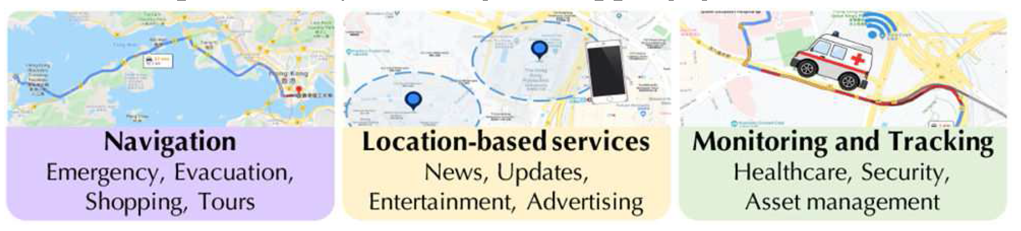
Introduction
Localization is determining the position of a device in a system. It is becoming a high value service^{[1]}
Primarily driven by emergency service in cellular networks
Digital transformation in industrial 4.0
Navigation
Location based
service
Monitoring and tracking
Localization applications
Notes:
Localization is determining the position of a device in a system. Wireless source localization has attracted considerable attention. emergency service in cellular networks. It is also driven by industrial 4.0, as a technique for digital transformation. Nowadays it has very general tentions over the decades, it is becoming a high value service^{[1]}. It was primarily driven by governmental force for applications^{[1]}.

Slide 4
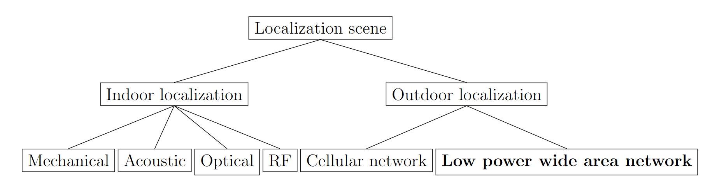
Introduction
Simplified localization scene taxonomy^{[1]}
Cellular network: mobile
Low power wide area network (LPWAN): Low power sensor, long range, low cost
Notes:
Localizing mobile devices in an outdoor environment typically utilizes the GPS.
LPWAN: low frequency, high wavelength, long transmission range, low bit rate, low cost
The goal of this project is to develop localization technique under LPWAN schema, that we deploy localization methods on low power sensors and in urban env.

Slide 5
Localization methods
Radio frequency (RF) is a conventional media for localization^{[2]}
RF based methods
Range-based: geometric mapping, vulnerable to multipath effect
Trilateration
Triangulation
Range-free
Fingerprint: localization by best match fingerprints
Proximity: localization by reachable dense beacons
Rx
Tx
Line-of-sight (LOS)
Non-line-of-sight (NLOS)
Multipath effect
Notes:
Range-based methods base on geometric mapping techniques such as trilateration, triangulation for range estimation and target localization. The range estimation normally relies on measurements such as RSSI, ToA, TDoA from different terminals. It requires at least 3 devices to determine one sensor’s position and is vulnerable to multipath effect
Unlike Range-based algorithms, range-free methods do not require absolute distance estimation. It operates on connectivity information between nodes, They are basically implemented from fingerprinting or proximity techniques.
n fingerprint approach, each available node is represented by a unique channel fingerprint, the localization is achieved by finding the most matched fingerprint
Proximity method: It applies dense beacons in network. transmitter position is assigned by the position of reacheable beacon

Slide 6
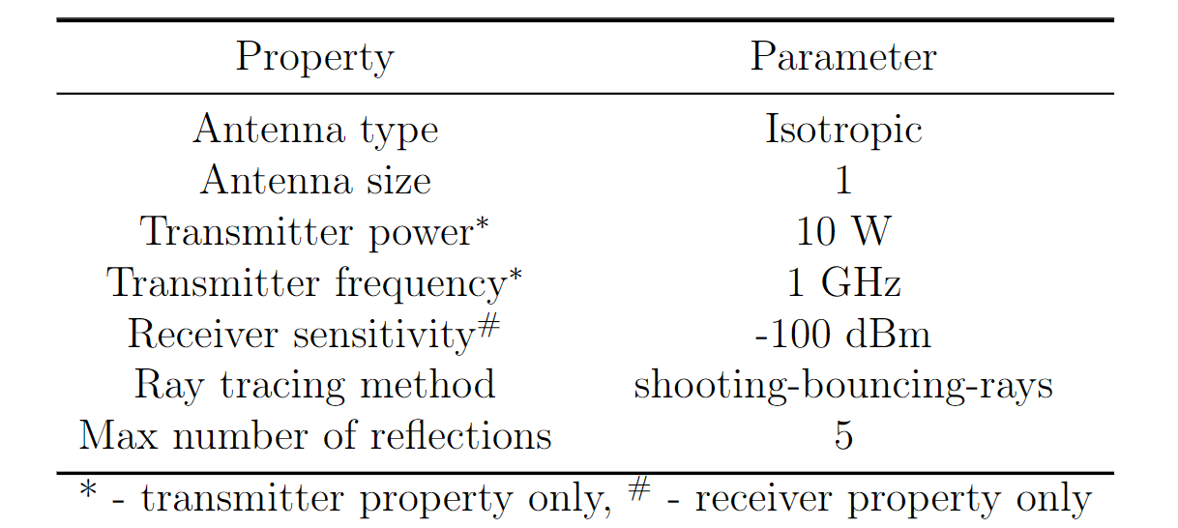
Simulation
Simulate the signal transmission process in WSN
Importance of simulation: saving cost, time
Build up on Matlab communication module for uplink
No encoding involved in signal transmission.
Isotropic antenna
Rx
Tx
SBR model (diffraction is not included)
Notes:
Before that, a simulator is required for data generation, which can largely reduce the time and economic cost comparing with real experiments. Simulator is for simulator the way signal propogates from tx to rx.
Simualtor is to simulate tx and rx communicate in a network. Their environment and hardware setup need to be configured. The configuration of the simulator is selected accordingly

Slide 7
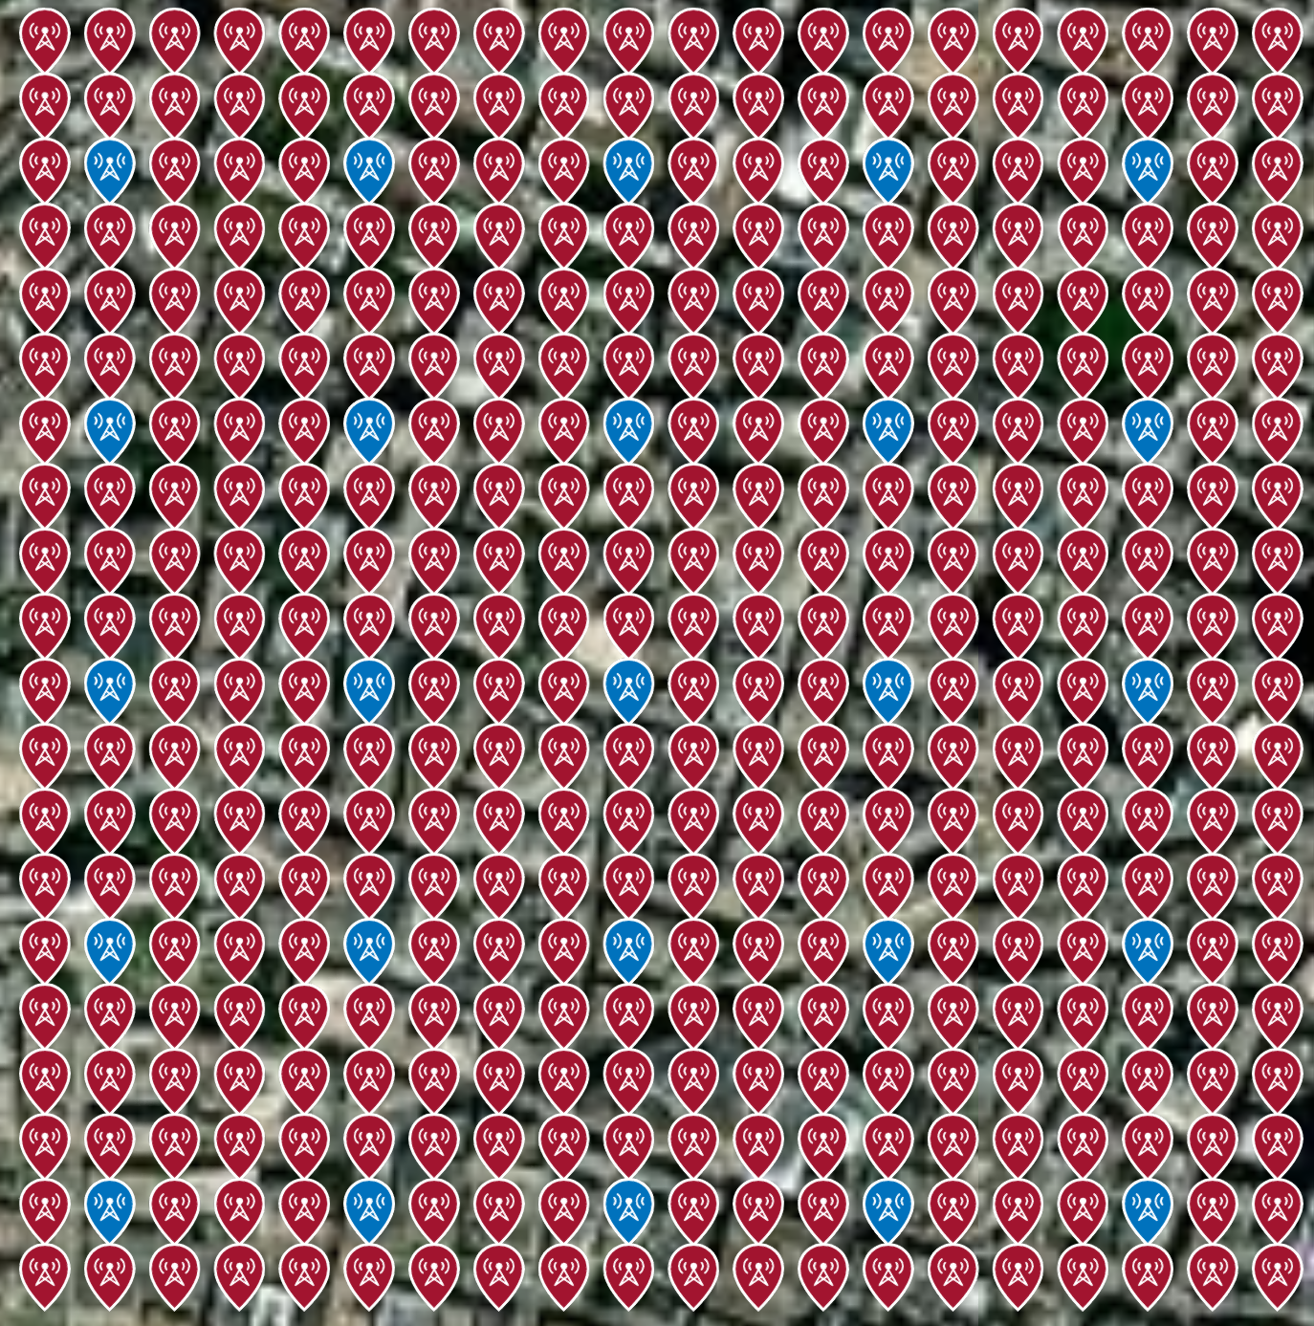


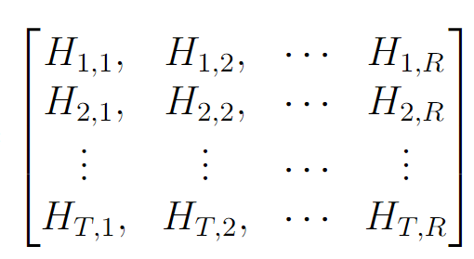
Simulator map setting
Wireless sensor network: transmitters and receivers evenly distribute in a square area.
1 km
#T transmitters
#R stations
…
1 km
…
…
The generated cell will be of T rows and R columns. Each entry H stores the fingerprint from corresponding Tx and Rx

Slide 8
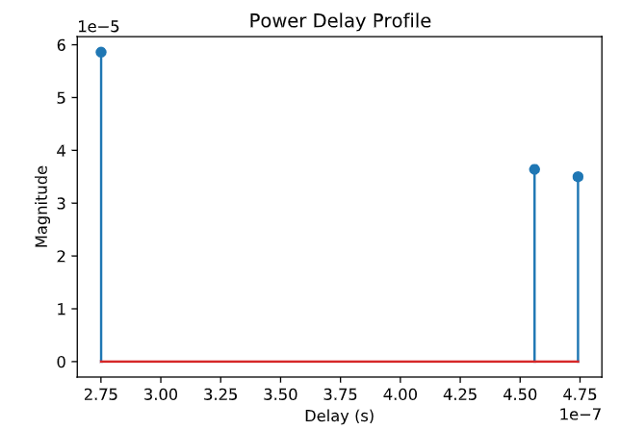
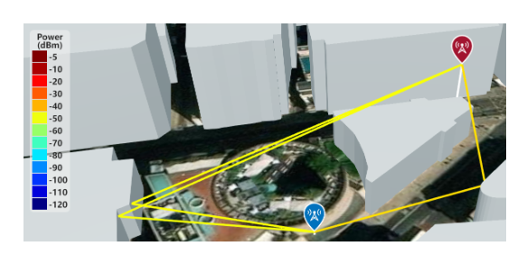
Fingerprint measurements
Radio frequency (RF) based candidates: received signal strength, Time of Arrival (AoA), Time Difference of Arrival (TDoA), channel impulse response etc.
Channel impulse response (CIR) brings rich environmental information. It can discriminate multipath effect.
Τ₂₁ a₂₁
Τ₂₂ a₂₂
Τ₂₃ a₂₃
Illustration of communication between a Tx and a Rx
2D array of time and magnitude
Notes:
Channel impulse response (CIR) brings rich information about enviroment complexity, and distance between Tx and Rx, it can also discriminate multipath effect.
3 ray trace are simulated, each trace corresponds to on impluse. 2D array of length 3

Slide 9
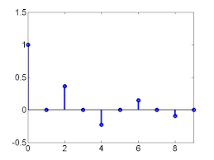
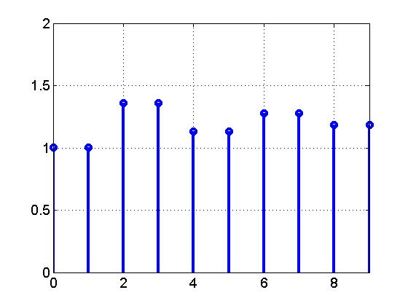
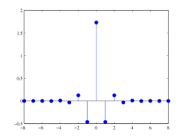
Preprocessing
Max length M
Τ₁₁ a₁₁
Τ₁₂ a₁₂
0
0
0
0
…
Merge all fingerprints in the database.
flatten
Dataset X: T × (R*(M*2))
…
T₁
T₂
…
a1
a2
…
=
…
…
…
T₁
T₂
T₃
…
a1
a2
a3
flatten
Τ₂₁ a₂₁
Τ₂₂ a₂₂
Τ₂₃ a₂₃
0
0
…
Max length M
Notes:
How to merge fingerprints with different length to the same database.

Slide 10
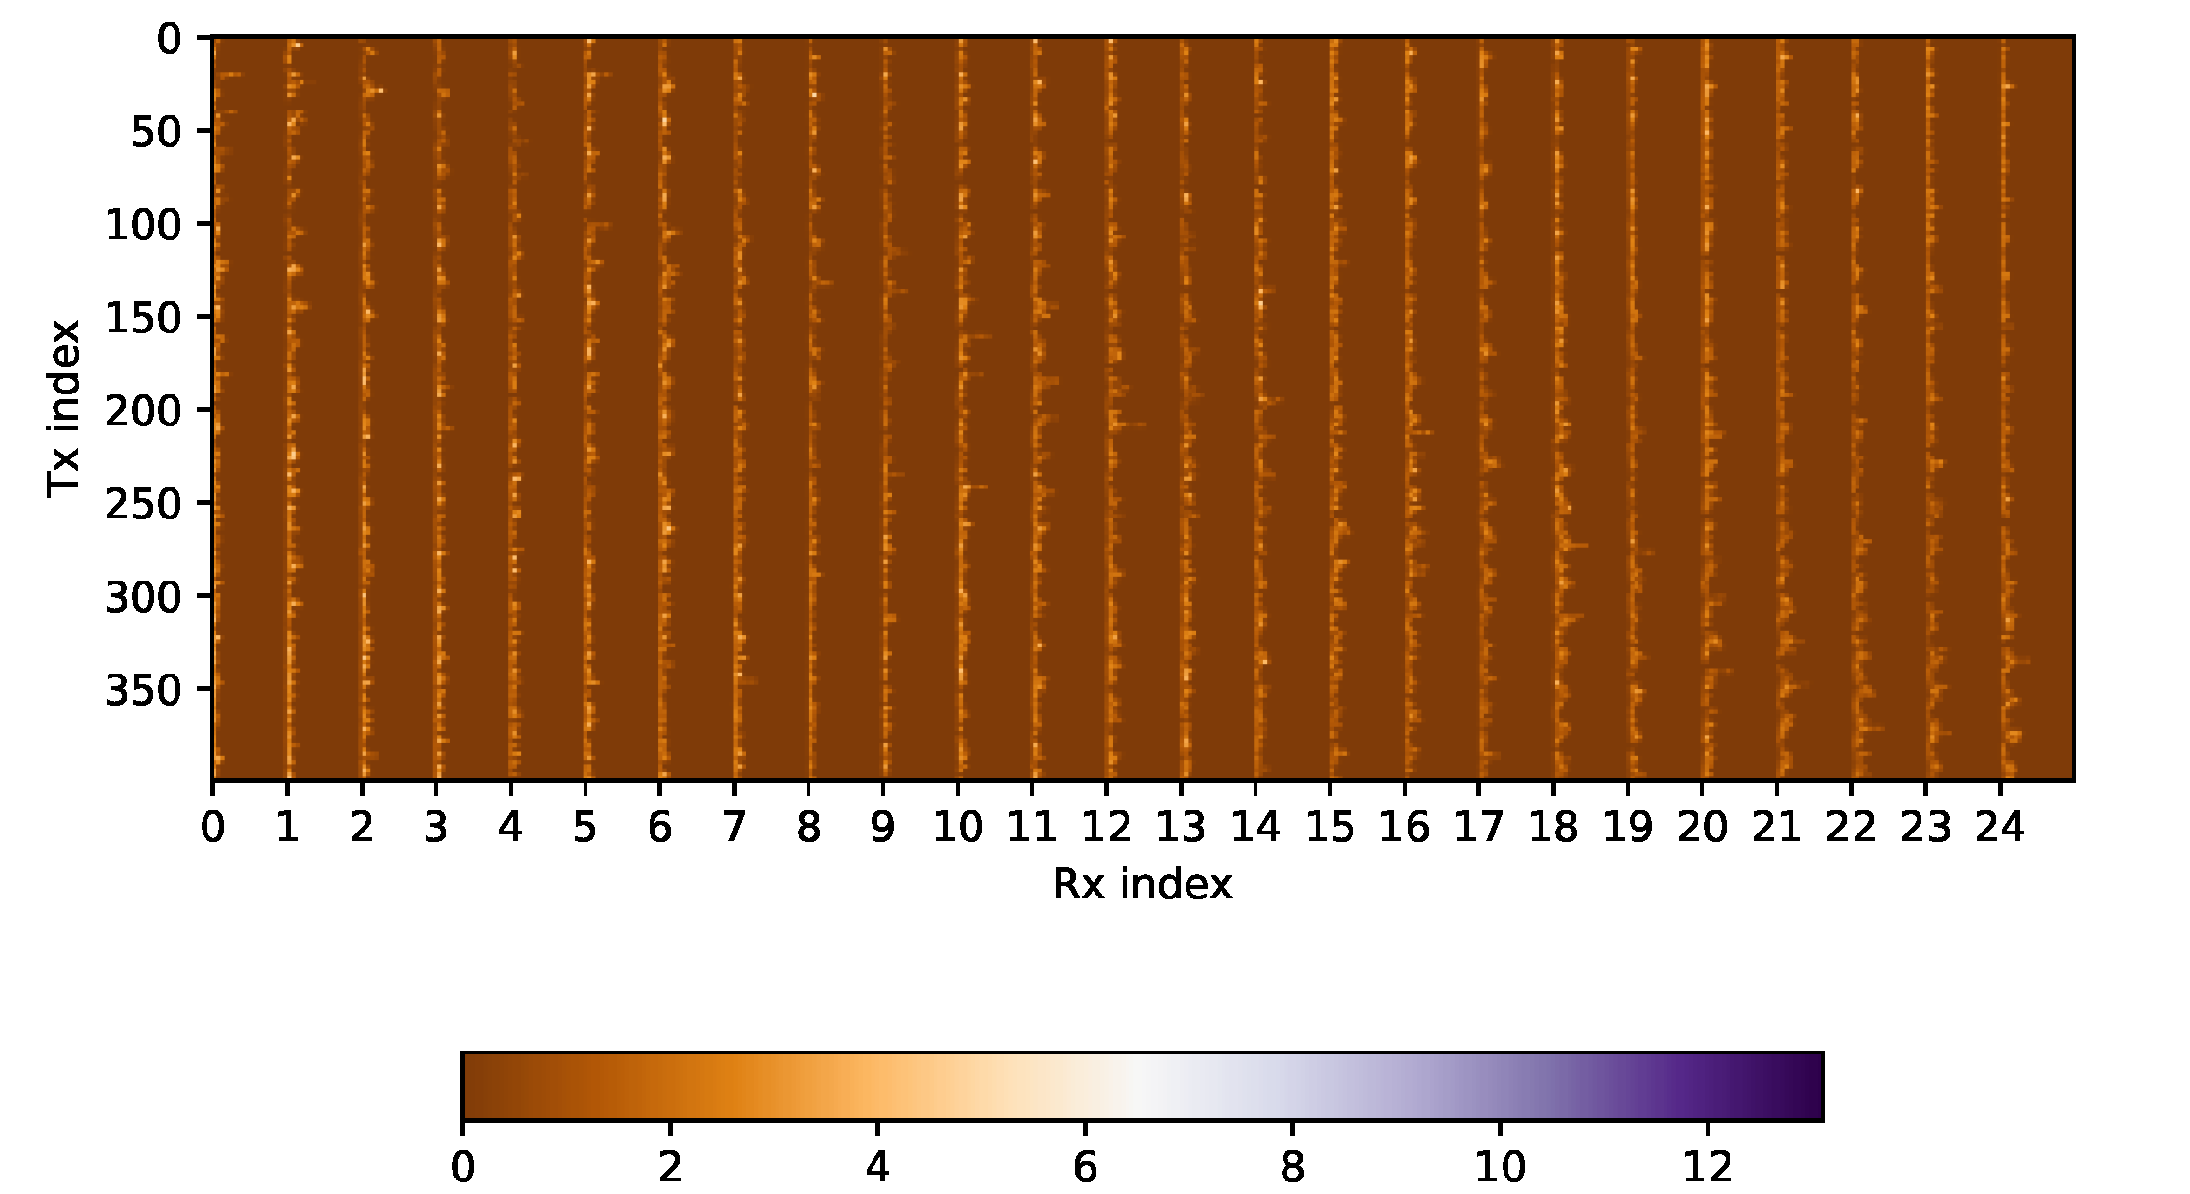
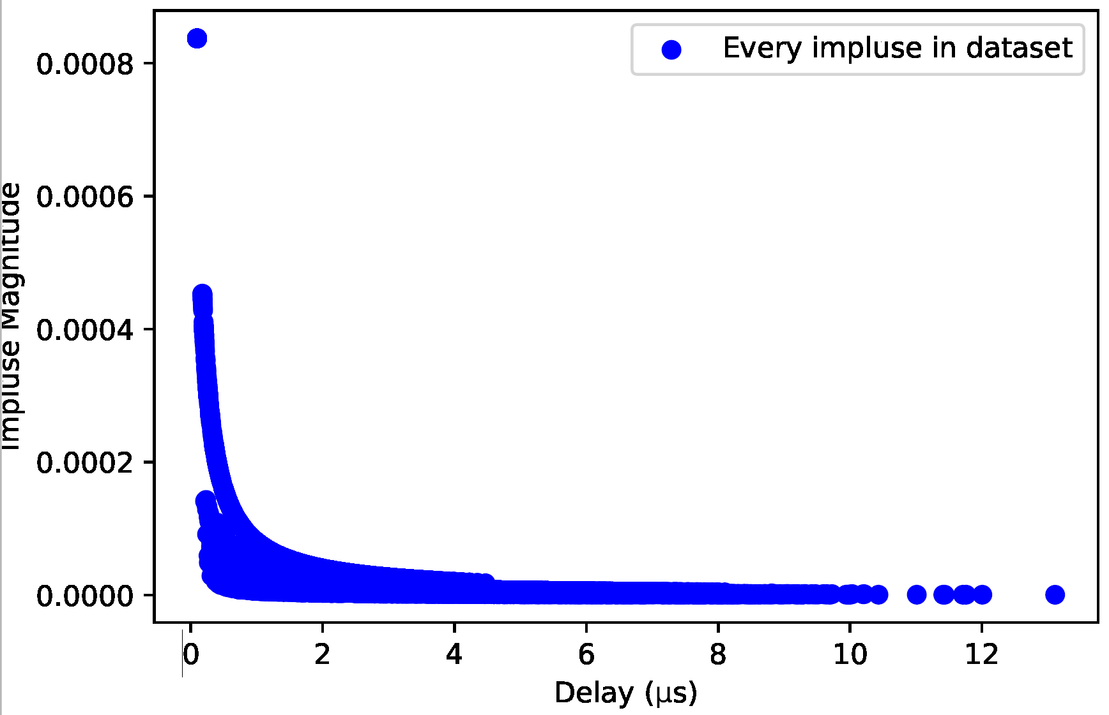
Data overview
One example of data from simulation in London, with 400 transmitters and 25 receivers, and CIR as signal measurements.
CIR overview
Notes:
One example of generated data is illustrated in the following. Each row corresponds to the fingerprint of one tx. Each pixel corresponds to one value in fingerprint.
Right graph gathers all the impulse collected in the network. There is a clear correlation between time delay and impulse magnitude. The longer the time delay,

Slide 11
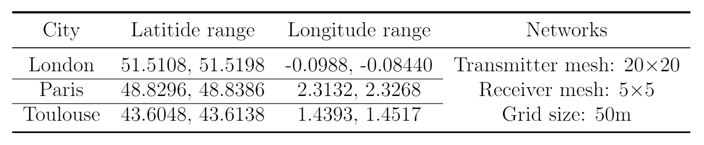
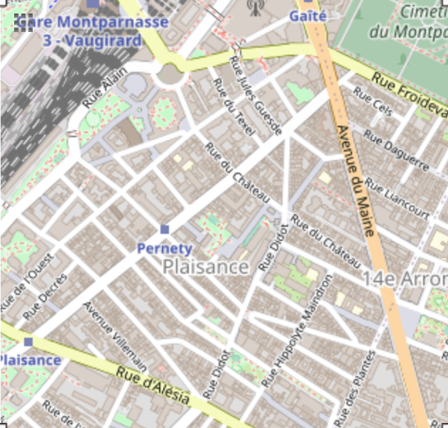
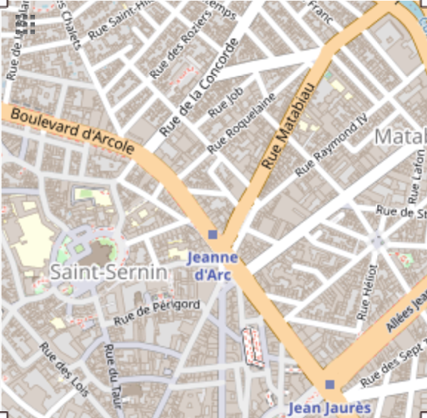
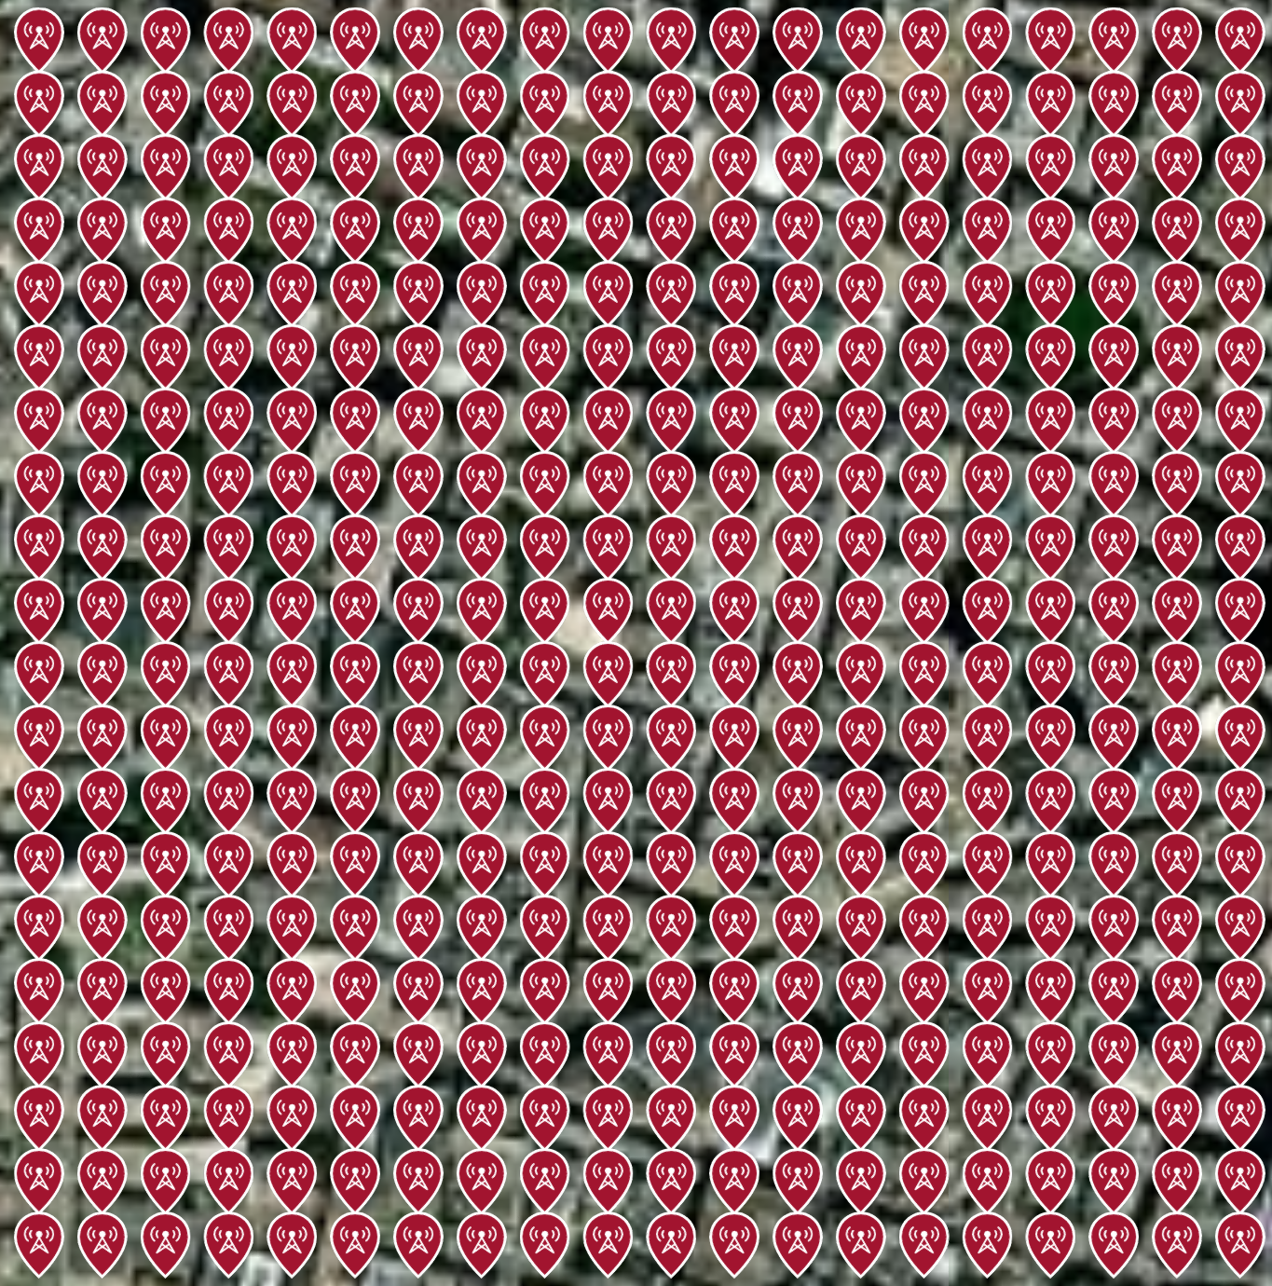
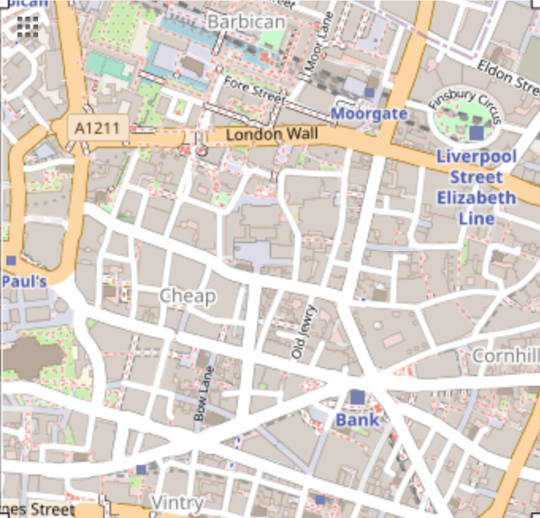
Simulation map
Simulations are conducted for several cities with same network configuration
London
Paris
Toulouse
Notes:
1km by 1km area in 3 cities are chosen for test bed, with 400 tx and 25 rx evenly distributed in. The distance between adjacent transmitters is 50m, called grid size.

Slide 12
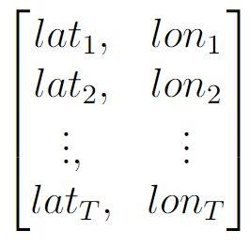
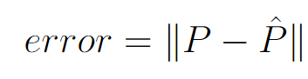
Problem formulation
Find a function mapping measurements to geolocation
f

Slide 13
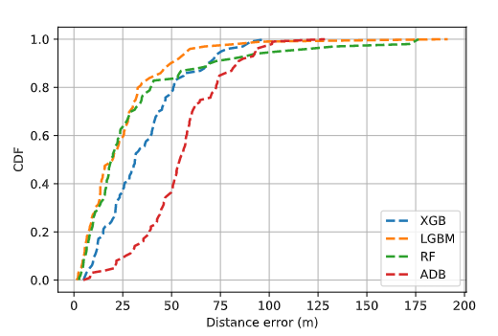
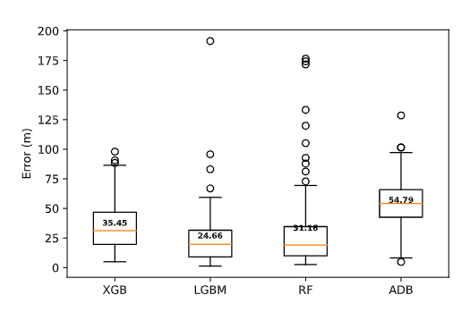
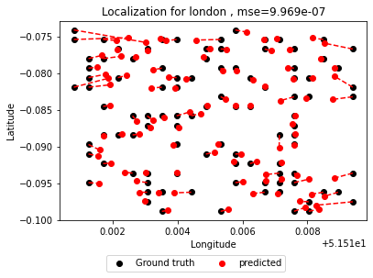
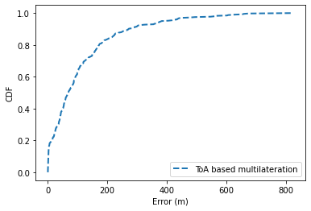
Localization with ensemble method
Training ensemble methods for location prediction on London dataset.
Cumulative distribution of localization errors using different ensemble methods
Cumulative distribution of localization errors using ToA based multilateration method^{[3]}
An illustration of localization error measurements: LGBM on London data
Boxplot of localization errors using different ensemble methods
Notes:
Make prediction on each test node, which generates estimation error. In total, the cdf of the group of estimation errors can be used for performance evaluation.
Ensemble methods are deployed for direct localization estimation. LGBM has a lowest mean value, with high variation. The localization error is generally around 50m.
For comparison, a range based method is implemented.

Slide 14

Transfer scenarios
Common problem for data driven methods: model generalization.
Is the model able to localize with data from other source?
Source Map
Target Maps
f
Notes:
Model learns from one type of problem, and then apply this learning to solve related problems

Slide 15
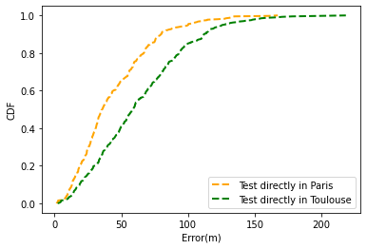
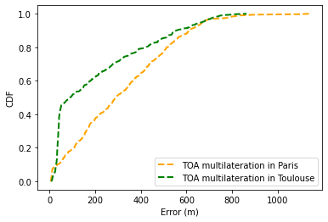
Testing on target data
Is the model able to localize with data from different maps?
Source map: London
Target map: Paris, Toulouse
LGBM model trained with data from London, test on Paris and Toulouse
Range-based model test on Paris and Toulouse data (benchmark)
Distance from London to Paris: 344 km
Distance from London to Toulouse: 887 km
The ensemble method: catastrophic
The range-based method: not satisfying
Notes:
Using ensemble method, predict on data from new sources. Its performance is catastrophic. The scale of the error is in the same scale of the distance from the target city to source city. Because it’s always predicted around London.

Slide 16
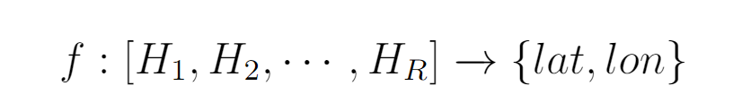
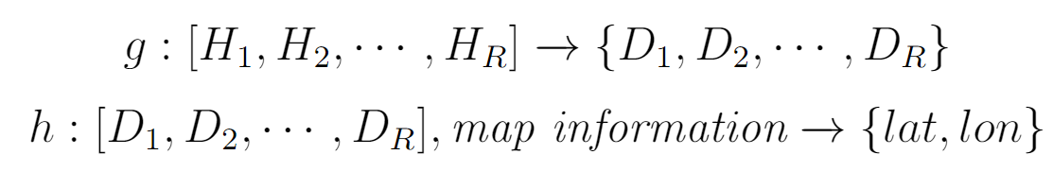
Transfer scenario
Location are labels with high variation. Learning features with less variation: distance between transmitters and receivers.
A new framework for data from different sources is proposed:
×
Notes:
Idea is to learn a feature with more stable distribution, variation.

Slide 17
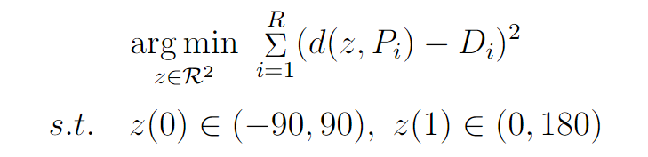
Transfer scenario
A new framework for data from different sources is proposed:
Model trained offline with source data. Predict distance of online target data, followed with point searching to find the position.
Source
Regressor
Offline training
Online testing
Target
Regressor
Distance
Point searching
Latitude
Longitude
Rx position
d*

Slide 18
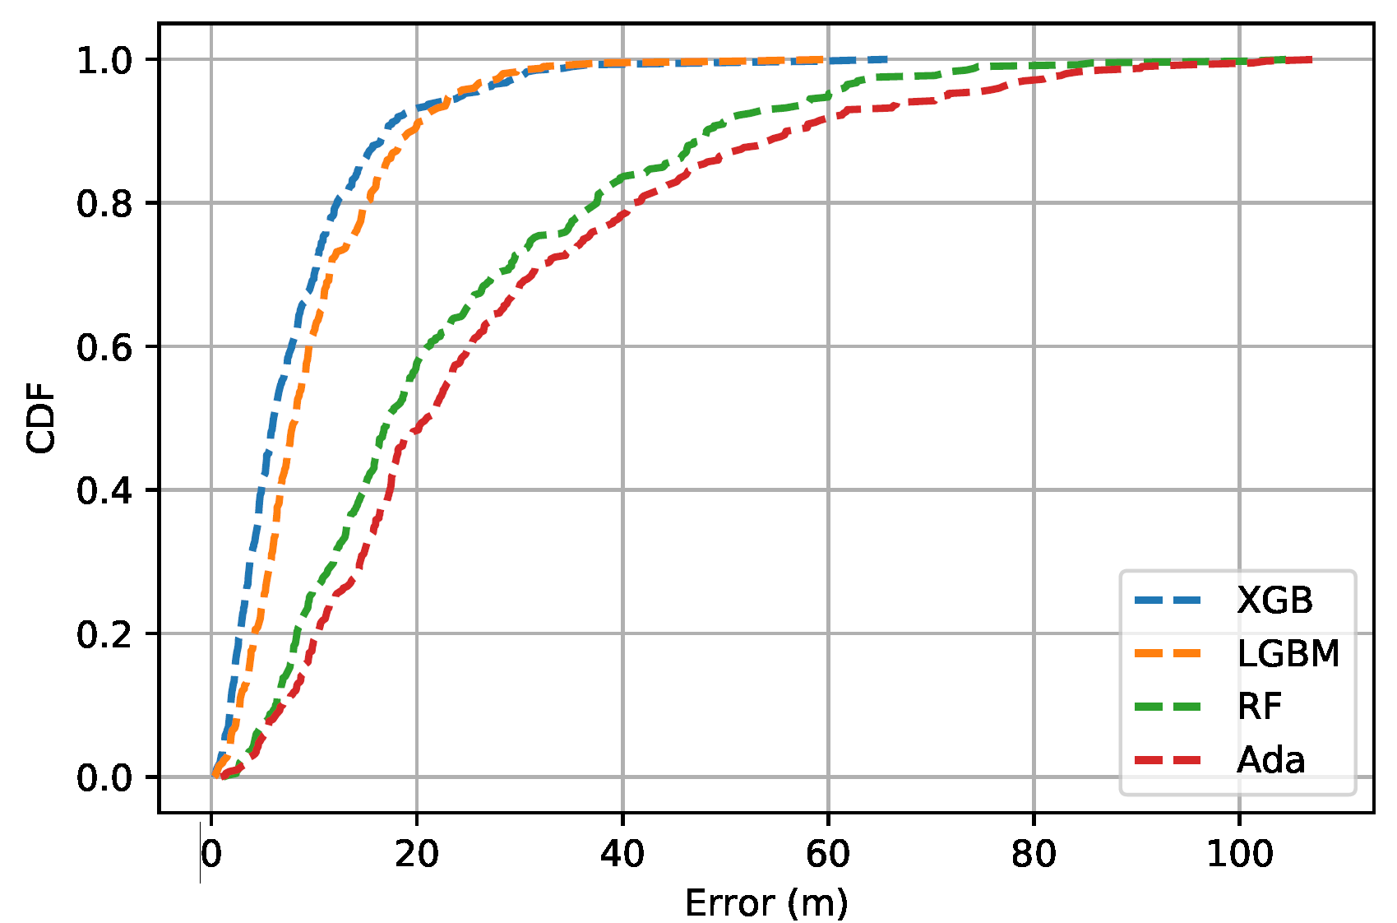
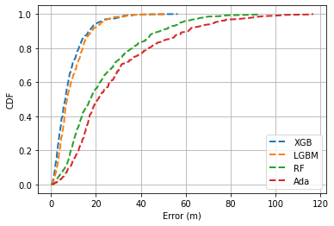
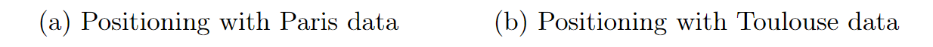
Experiment
Source – London; Target – Paris, Toulouse
Regressor for distance prediction on data from London, running test in Paris and Toulouse
Notes:
Following the proposed framework,
Regressor for distance prediction is trained with data in London and supplemented data from Paris or Toulouse.

Slide 19
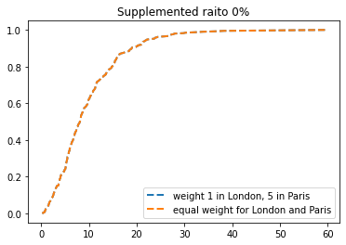
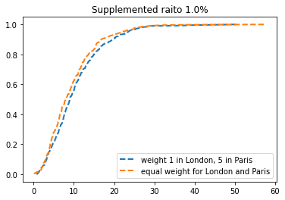
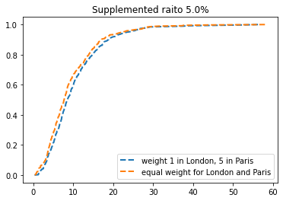
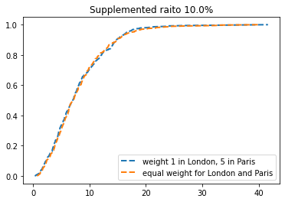
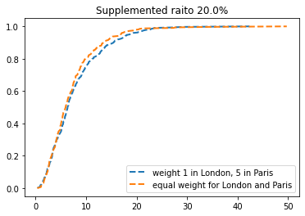
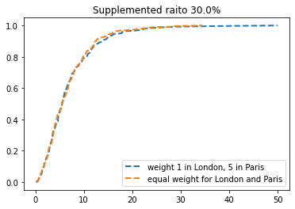

Slide 20
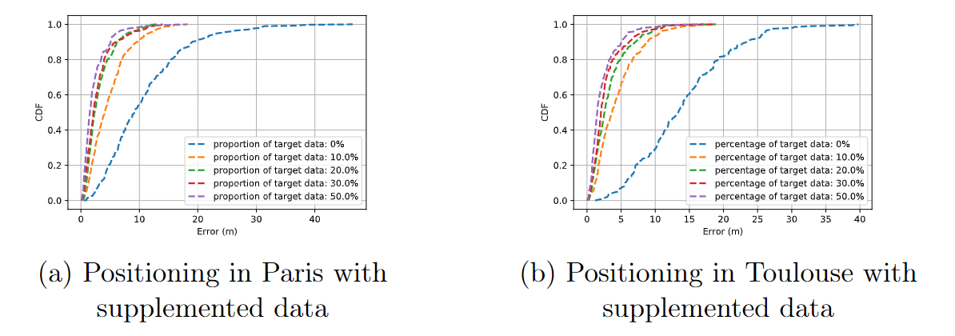
Experiment with supplemented data
Source – London + supplemented data from target source;
Target – Paris, Toulouse

Slide 21
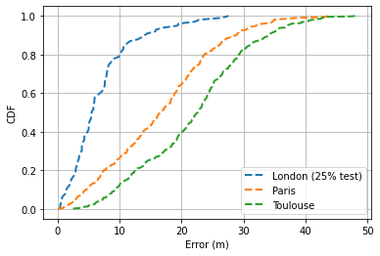
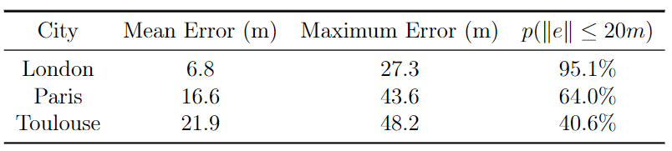
Experiment on data source comparison
Model trained with 75% London data, and tested on Paris, Toulouse and 25% London data.
The model performs better on data from same source.
Notes:
Data from the same source fits the model better, and then results in better performance

Slide 22
Conclusion
This work explored fingerprint-based localization methods with data generated from simulation, and proposed a novel framework to localize on data from different source. Its performance outperforms the benchmark largely. The chosen benchmark is not comparable with proposed method. One main reason is it is hard to find a method could be directly applied in this study. Only range based methods care chosen for comparison which has an expected poor performance.

Slide 23
Perspective
Preprocessing: more features could be extracted from CIR
Simulation: noise could be considered in simulation to generating more realistic data
Localization with data from different source: use more prior map information
Find a better benchmark for comparison
Continuous transmission
Transfer learning: new data with different weights
…

Slide 24
Reference
Quoc Duy Vo and Pradipta De. A survey of fingerprint-based outdoor localization. IEEE Communications Surveys Tutorials, 18(1):491–506, 2016.
José A. del Peral-Rosado, Ronald Raulefs, José A. López-Salcedo, and Gonzalo Seco-Granados. Survey of cellular mobile radio localization methods: From 1g to 5g. IEEE Communications Surveys Tutorials, 20(2):1124–1148, 2018.
Norrdine, Abdelmoumen. (2015). An Algebraic Solution to the Multilateration Problem. 10.13140/RG.2.1.1681.3602.

Slide 25
Thanks for listening ~

Slide 26

Transfer scenarios
f
Paris
London
Toulouse

Slide 27
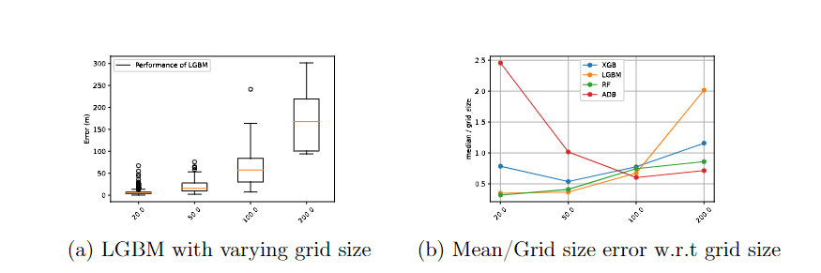

Slide 28
